Slide 1
HMAD
Hybrid mobile application development

Slide 2
Contents:
Introduction
History
Market Shares
Building a simple application

Slide 3
Introduction
Today mobile device users prefer to use applications installed on their smartphones. They use installed applications (apps) for carrying out routine activities like watching videos, playing their favourite songs and chatting with friends and sharing especial moments.
This trend is confirmed by Gartner, which has this to say: “Enterprises are finding that they need to support multiple platforms, especially as the BYOD [bring your own device] trend gains momentum.”
The market share of mobile devices is divided mainly into Android, iOS, and Windows Phone. Because of the differences in platforms/operating systems, creating an installable mobile application that targets multiple device platforms requires too much of effort and expertise.
This can be overcome by using hybrid mobile applications, a solution based on HTML 5, JavaScript, and CSS 3. These hybrid applications are created once, but after packaging can be deployed on multiple mobile devices such as Android, iOS, and Windows Phone.

Slide 4
History
In 1980’s, the mobile technology landscape consisted of mobile phones the size of a carryon suitcase and personal organizers that looked like glorified financial calculators. Wireless networks and widespread access to resources like the Internet were distant dreams. Unless you were a science fiction writer, it would have been hard to imagine the connected world that we take for granted today.
In 1983 came the Motorola DynaTAC 8000X cell phone—the first commercial cell phone. People called it a brick because of its 2.5 pound weight and it was sold at the price of $3,995! This phone could do little more than calling.

Slide 5
The first innovations came from Nokia and other manufacturers who took this technology to another level by adding more functionality, including games such as Snake and Ping Pong. Mobile applications were limited to those preinstalled by vendors. However, some vendors did offer applications using the Wireless Application Protocol (WAP). These applications were available from the phone manufacturers.
In November 1993, IBM launched Simon. It had preinstalled applications such as a calendar, a clock, a calculator, a notepad, and email. It also had a stylus!
In 2002, Research In Motion Limited (RIM), now BlackBerry Limited, released its first device with integrated phone functionality. The product line eventually evolved into the first mass-market smartphone optimized for wireless e-mail. Mobile device users still had to wait until 2007 for a revolutionary change!

Slide 6
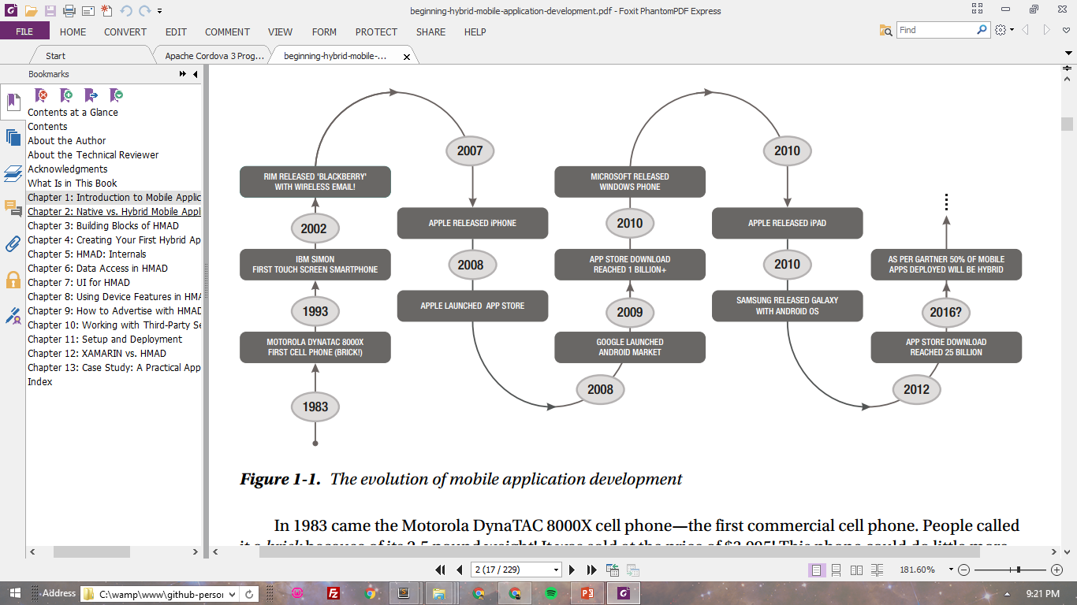
In 2007, Apple released the first iPhone, followed by the App Store launch. Users now had lot of choices for installing applications easily. A few months later, this was followed by the launch of the Android Market by Google, and the first Android-based smartphone from HTC called HTC Dream.
Apple offered its first iPad in 2010, giving users the option to use apps from their App Store. In the same year, Samsung launched a tablet named Galaxy based on the Android OS.

Slide 7
PhoneGap was started at the 2008 iPhoneDevCamp by Nitobi as a way to
simplify cross-platform mobile development.
In late 2011, Nitobi announced that it was donating PhoneGap to the Apache Foundation. Very quickly thereafter, Adobe announced that it was acquiring Nitobi. PhoneGap joined the open source Apache project as an incubator project, first as Apache Callback, briefly as Apache DeviceReady, and finally (beginning with version 1.4) as Apache Cordova (the name of the street where the Nitobi offices were located when PhoneGap was created).
Apache Cordova is a free, open source framework for building cross-platform native applications using HTML5. The creators of Apache Cordova wanted a simpler way of building cross-platform mobile applications and decided to implement it as a combination of native and web application technologies. This type of mobile application is called a hybrid application.

Slide 8
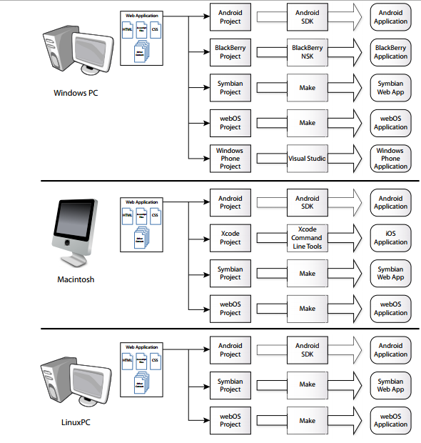
Cordova implements a suite of APIs that extend native device capabilities (such as the camera, accelerometer, Contacts application, and so on) to a web application running within the native container.

Slide 9
What Does the Market Say?
For the second quarter of 2015, the International Data Corporation (IDC) indicated the following share of the smartphone market:
Android by Google: 82.8%
iOS by Apple: 13.9%
Windows Phone by Microsoft: 2.6%
Others: 0.4%
BlackBerry by RIM: 0.3%

Slide 10
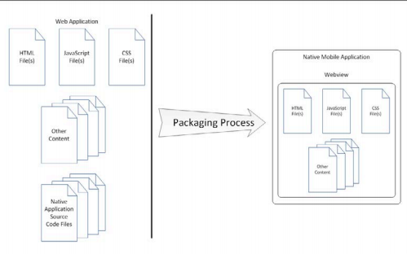
Let’s try to build an app.
To build a Cordova application, you create a web application, package the web application into the native container, test and debug the application, then distribute it to users (typically through an app store). That’s all there is to it.

Slide 11
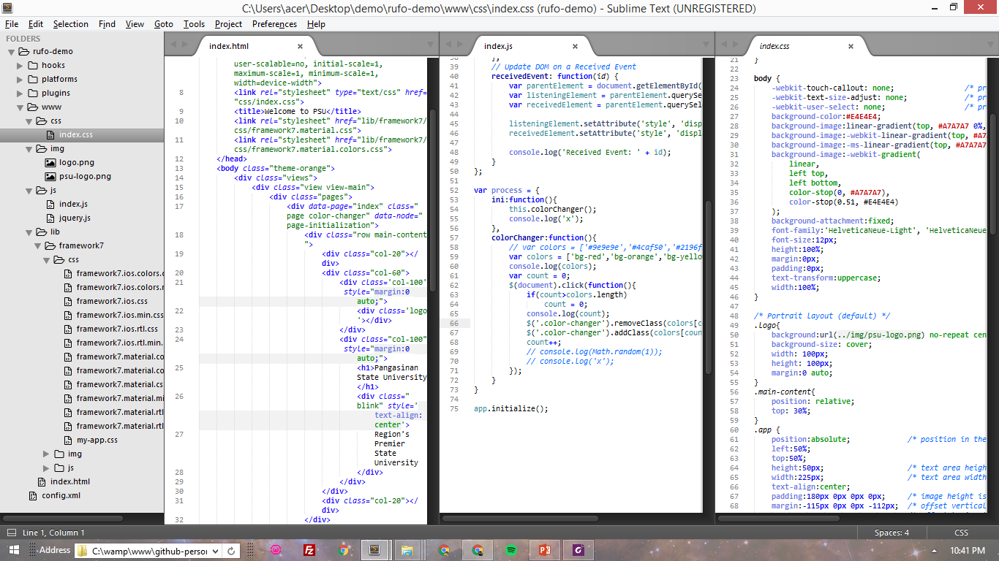
Things needed to develop a mobile app:
HTML5
for App’s structure.
JavaScript
for processes – user to app interaction.
CSS
for aesthetics – design.
UX and UI.
Others
other files like images, picture, video, etc.

Slide 12
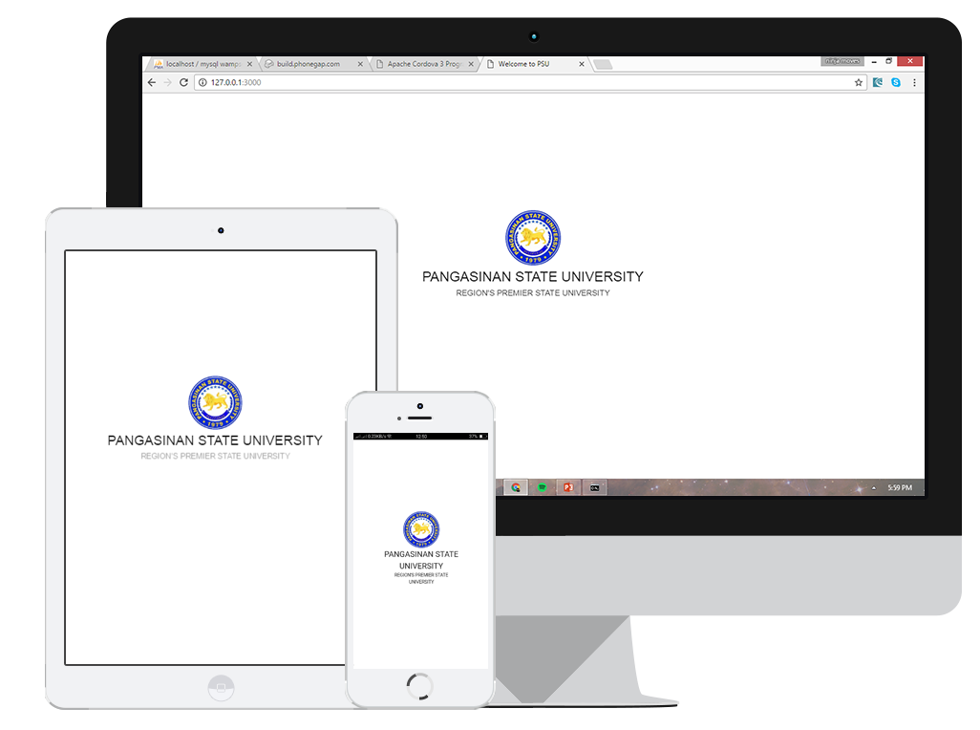
*The app created in Cordova doesn’t just fit in Android alone. It is also great in mobile devices like smartphones, tablets or iPad, Laptops and Desktop.

Slide 13
Thank you for listening.
Reported by: Rufo N. Gabrillo Jr.
Resources:
www.idc.com/prodserv/smartphone-os-market-share.jsp
http://cordova.apache.org
Beginning Hybrid Mobile Application (2013) by Mahesh Panhale
ISBN-13 (pbk): 978-1-4842-1315-5
ISBN-13 (electronic): 978-1-4842-1314-8
Apache Cordova 3 Programming (2016) by John M. Wargo
ISBN-13: 978-0-321-95736-8
ISBN-10: 0-321-95736-9

